Slide 1

Neural networks for brain tumour segmentation with domain adaptation
Sharon Wang

Slide 2
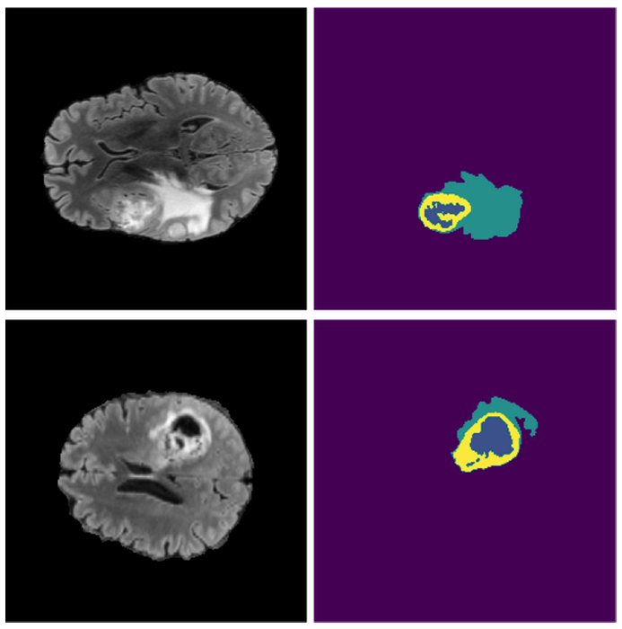
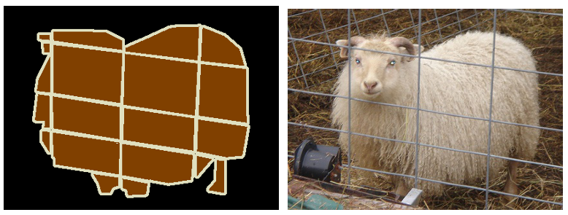
Problem statement

Slide 3
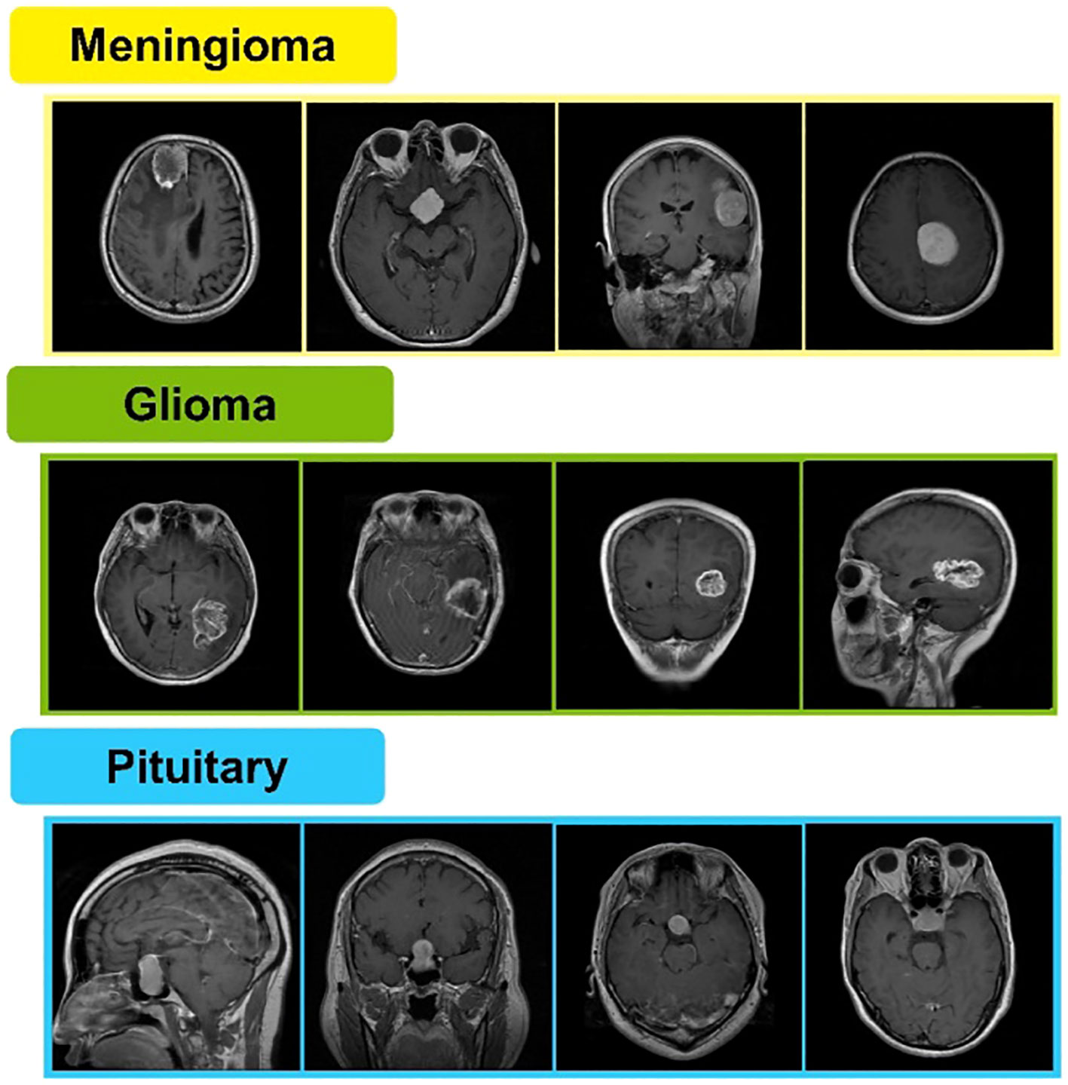
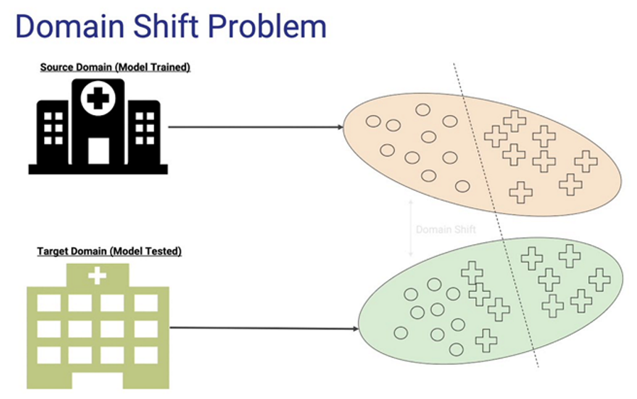
Domain shift

Slide 4
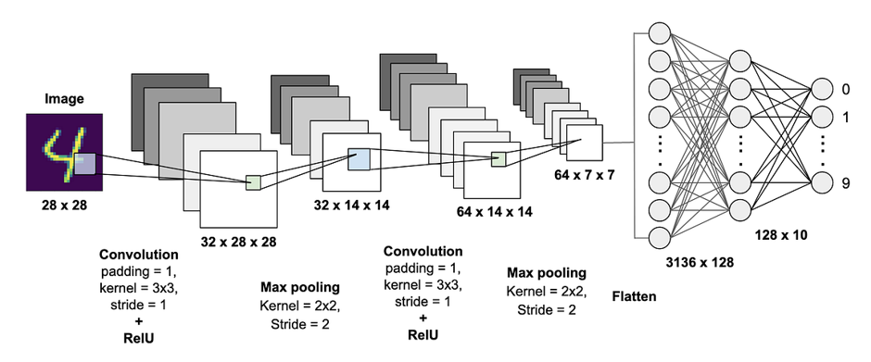
CONVOLUTIONAL Neural network

Slide 5
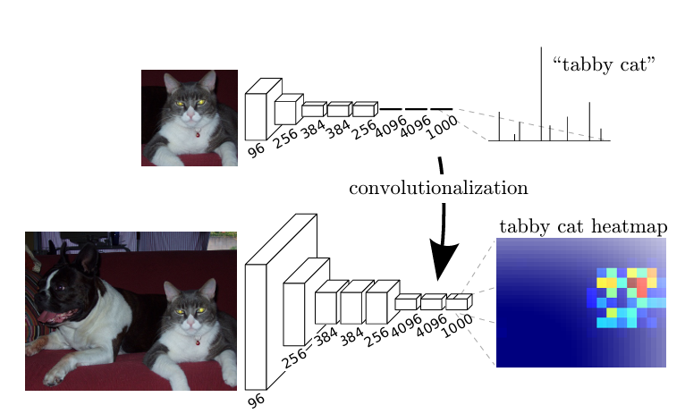
Fully convolutional neural network

Slide 6
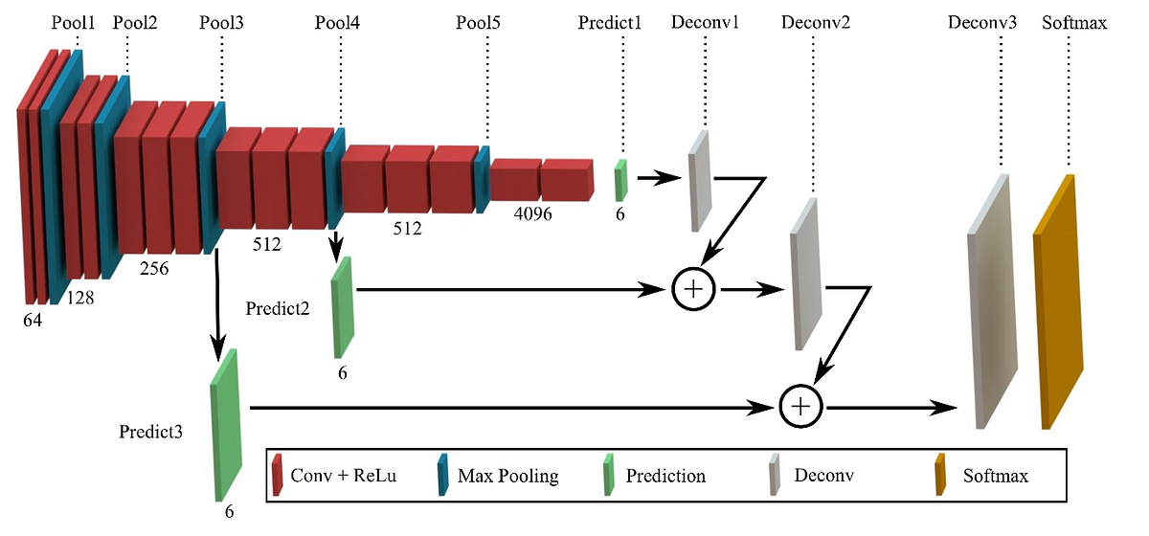
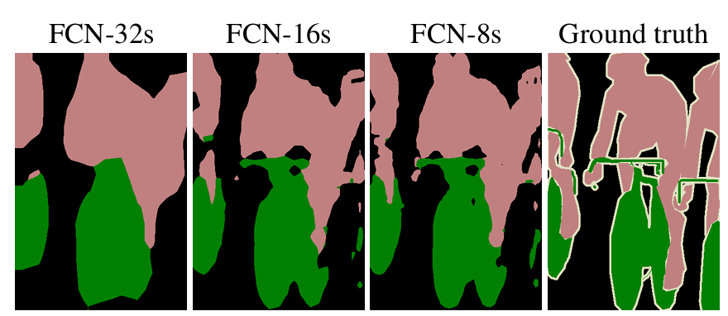
Decoder & Skip connections

Slide 7
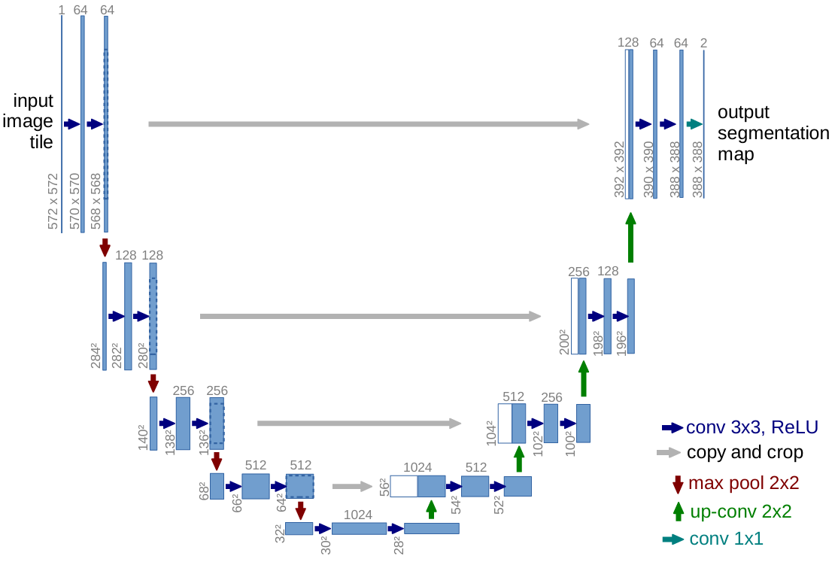
U-Net

Slide 8
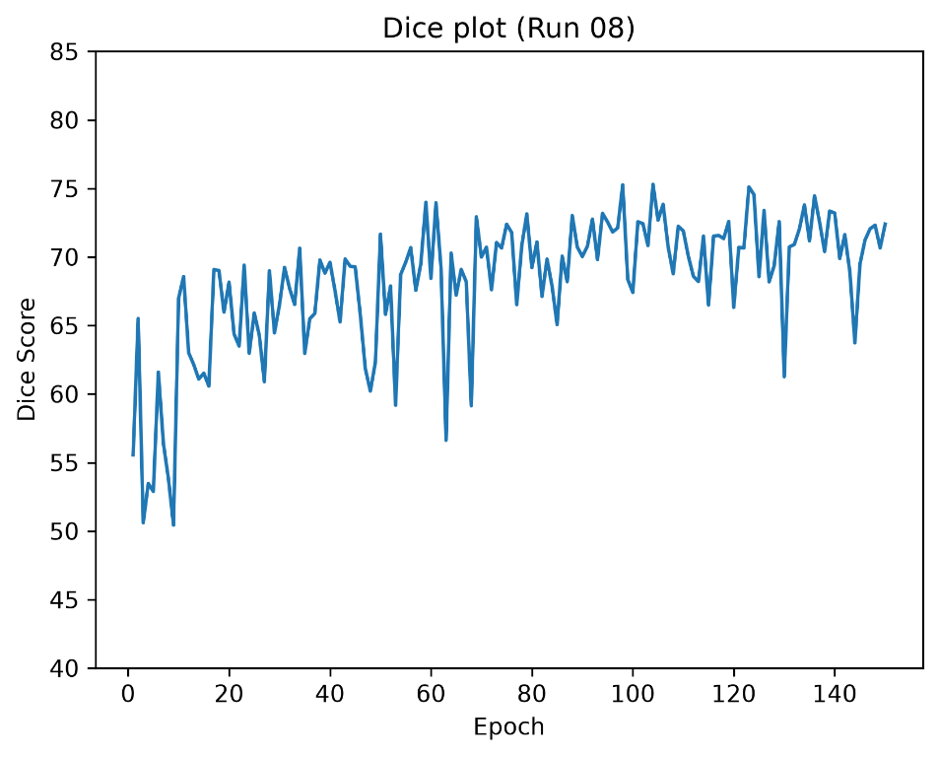
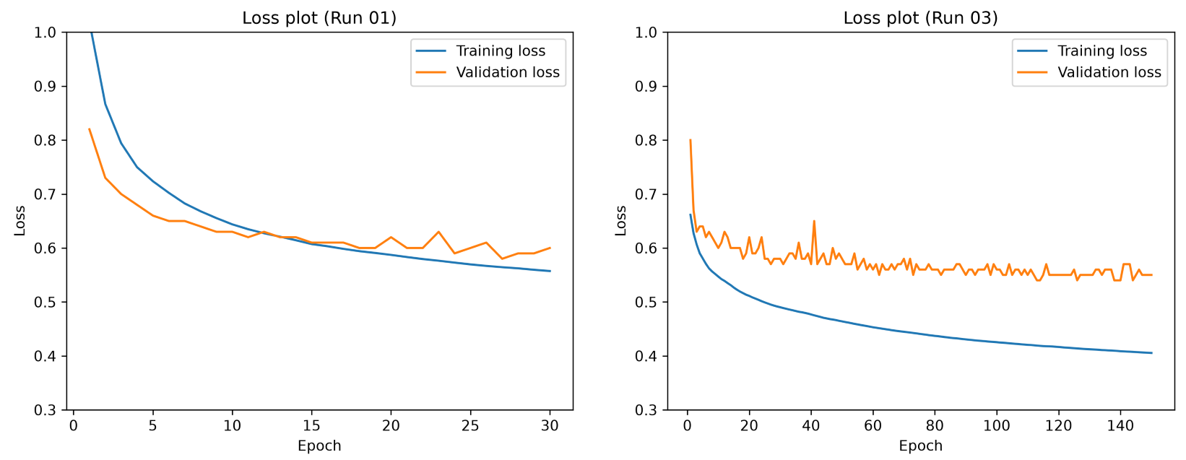
Training base model

Slide 9



Segmentation results

Slide 10
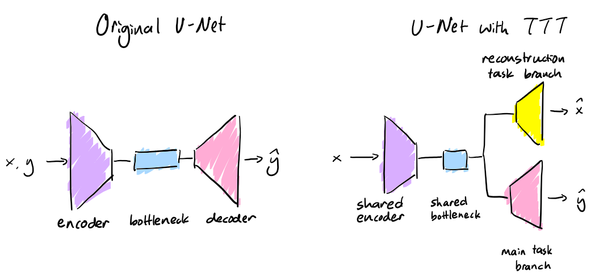
Test-Time training

Slide 11
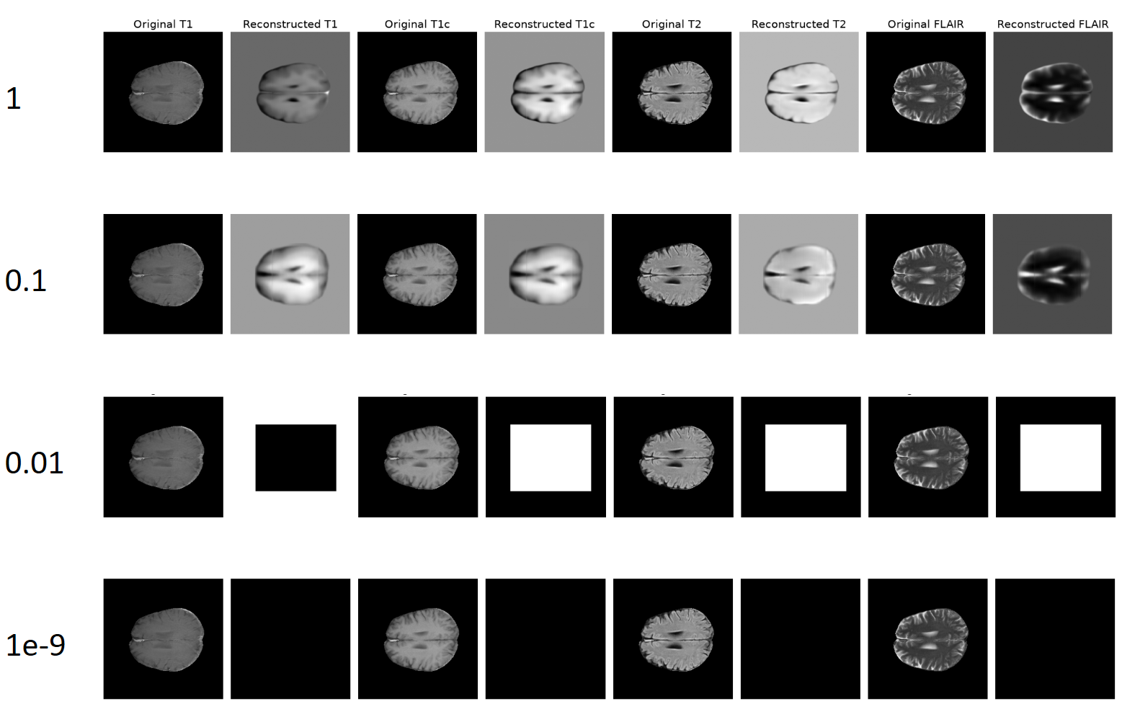
Reconstruction examples

Slide 12


Model performance
Before TTT:
After TTT:

